Slide 1
Psychopathology: Behavioral Disorder
Here is where your presentation begins

Slide 2
Contents of this template
You can delete this slide when you’re done editing the presentation
Fonts | To view this template correctly in PowerPoint, download and install the fonts we used
Used and alternative resources | An assortment of graphic resources that are suitable for use in this presentation
Thanks slide | You must keep it so that proper credits for our design are given
Colors | All the colors used in this presentation
Icons and infographic resources | These can be used in the template, and their size and color can be edited
Editable presentation theme | You can edit the master slides easily. For more info, click here
For more info:
SLIDESGO | BLOG | FAQs
You can visit our sister projects:
FREEPIK | FLATICON | STORYSET | WEPIK | VIDEVO

Slide 3
Table of contents
01
02
03
04
05
06
The disease and its symptoms
People at risk
Risk factors
Available treatments
Prevention and control
Conclusion

Slide 4
01
The disease and its symptoms

Slide 5
Introduction to the disease
On the first part of the presentation, it’s important to give an overview of the disease you’re going to speak about. This helps your audience understand:
The context
The health risks
Likelihood of developing it
Prevalence

Slide 6
Who is at risk?
Genetic factors
Environmental factors
When a genetic factor puts a person at risk of developing an illness, it means that there is a hereditary component to that illness. This can be due to specific genetic mutations or variations that increase a person's susceptibility to developing the illness
When an environmental factor puts a person at risk of developing an illness, it means that exposure to certain substances, conditions or situations in the environment can increase the likelihood of developing that illness

Slide 7
Types of diseases
Types
Spread
Duration
Diseases vary based on transmission, like communicable (spreadable) and non-communicable (non-spreadable). They can also differ in duration: acute (short-term) or chronic (long-lasting)
Diseases spread as communicable or stem from genetics/lifestyle as non-communicable. Recognizing how diseases transmit informs preventive measures, while understanding non-communicable causes aids in lifestyle adjustments
Diseases range from acute, with sudden symptoms and short span, to chronic, with prolonged effects. Managing acute cases requires swift action, while chronic conditions demand continuous care to alleviate lasting impact

Slide 8
Four main types of treatments
Medical treatment
Behavioral therapy
This involves the use of medications, surgery, radiation therapy, chemotherapy or other medical procedures to treat a particular illness
Behavioral therapies involve various techniques that are used to treat mental health conditions, such as depression, anxiety and addiction
Alternative therapies
Lifestyle changes
Alternative therapies include a range of treatments that are not considered part of conventional medical practice
Lifestyle changes involve making modifications to an individual's diet, exercise habits or other behaviors

Slide 9
Risk factors
Age
Genetics
Lifestyle
Many diseases occur more frequently in certain age brackets
Some diseases have a hereditary component and can be passed down through families
Certain behaviors can increase the risk of developing
certain illnesses
Environment
Medical history
Gender
Exposure to certain substances in the environment can increase the risk of developing some diseases
A personal or family history of certain illnesses can increase the risk of developing related or similar conditions
Some illnesses are more common in one gender than the other

Slide 10
10,000
85%
1,000
Patients treated
Success rate
Suffered secondary effects

Slide 11
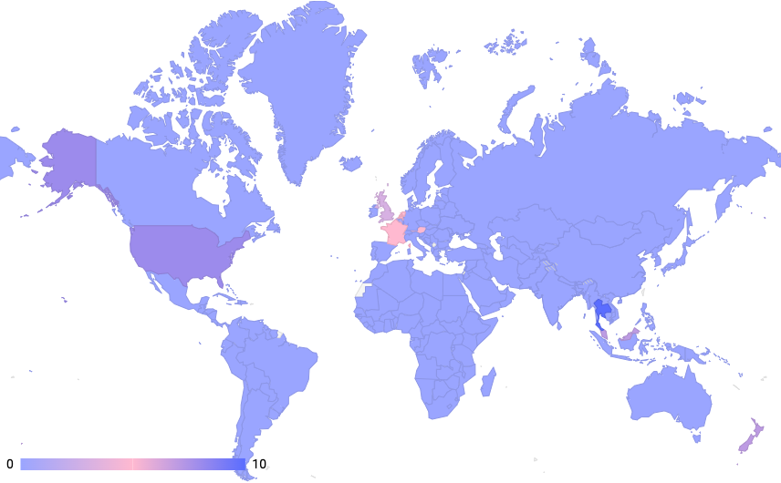
Disease prevalence
0-5% of the population in these regions are affected by the disease
6-14% of the population in these regions are affected by the disease
15-30% of the population in these regions are affected by the disease
Follow the link in the map to modify its data and then paste the new one here. For more info, click here

Slide 12
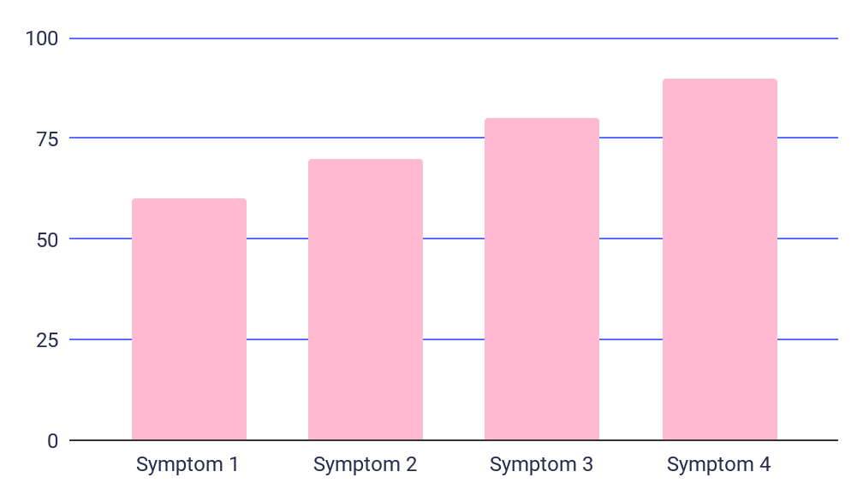
Symptoms and diagnosis
Most common symptoms
Use this slide to display the most common symptoms of the disease being discussed. Include a graph with a clear title and labels for each axis. You can also explain how the disease is diagnosed, including the types of tests or procedures used, to help your audience understand how it is identified and treated
Follow the link in the graph to modify its data and then paste the new one here. For more info, click here

Slide 13
Risk factors and complications
Risk factors | Description | Prevalence | Contributing factors | Complications | Severity
Enter the risk factors here | In this part, include a brief description | 80% of cases | Enter the contributing factors here | In this part, enter the complications of the disease | High
Enter the risk factors here | In this part, include a brief description | 30% of cases | Enter the contributing factors here | In this part, enter the complications of the disease | Moderate
Enter the risk factors here | In this part, include a brief description | 40% of cases | Enter the contributing factors here | In this part, enter the complications of the disease | High
Enter the risk factors here | In this part, include a brief description | 10% of cases | Enter the contributing factors here | In this part, enter the complications of the disease | Moderate

Slide 14
Disease history
Discovery of the disease
Early research
First treatment
Milestone discoveries
01
02
03
04
05
06
07
08
Breakthrough treatment
Epidemic outbreak
Current research
Future directions

Slide 15
Diagnosis and treatment flowchart
Start
Patient symptoms
Diagnostic test
Diagnosis confirmed
Prescribed treatment
List the symptoms that the patient is experiencing:
Enter the symptoms of the patient
Enter the symptoms of the patient
Enter the symptoms of the patient
List the diagnostic tests that were performed:
Enter the diagnostic test performed
Enter the diagnostic test performed
Enter the diagnostic test performed
This step represents the confirmation or ruling out of a specific disease diagnosis based on the results of the
diagnostic tests
List the recommended treatment options
Enter the
treatment options
Enter the
treatment options
Enter the
treatment options
End

Slide 16
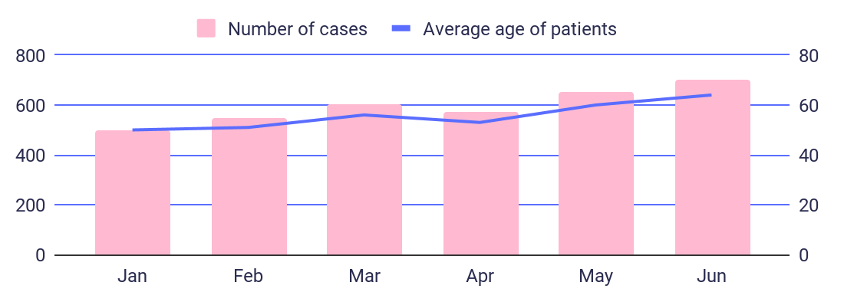
Disease management
Number of cases of the disease over time
Region | Number of cases | Percentage of cases
North | 1,000 | 20%
South | 2,500 | 50%
East | 1,200 | 24%
Describe the trend of the disease cases over time
Provide key insights or observations about the graph
Explain any significant changes or patterns in the graph
List the regions or areas that are relevant for the disease
Enter the number of cases for each region, area or country
Describe any notable variations or trends among the regions
Provide additional details or observations about the table
Follow the link in the graph to modify its data and then paste the new one here. For more info, click here

Slide 17
Disease overview and conclusions
Information
Causes | Enter in this section specific information about causes
Symptoms | Enter in this section specific information about symptoms
Diagnosis | Enter in this section specific information about the diagnosis
Treatment | Enter in this section specific information about the treatment
Prevention | Enter in this section specific information about prevention
Key findings
Summarize the most important or relevant aspects of the disease
Use bullet points to present the key findings in a clear and organized manner
Conclusions
1
In this section, summarize the key findings from the disease study
2
Provide an overview of the implications for the current diagnosis and treatment plan

Slide 18
Thanks
Do you have any questions?
youremail@freepik.com
+91 620 421 838
yourwebsite.com
Please keep this slide for attribution

